Slide 1
Shape Recognition using Conditional Random Fields
Dheeptha Badrinarayanan (dxb171030)
Deeksha Lakshmeesh Mestha (dxm172630)
Akash Chand (axc173730)

Slide 2
Overview
CRF Model
Training and Inference
Regularization
Testing results
To-Dos

Slide 3
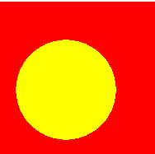

Design of our CRF Model
Dataset: http://www.iro.umontreal.ca/~lisa/twiki/bin/view.cgi/Public/BabyAIShapesDatasets
5000 32x32 grayscale images
3750 training instances + 1250 rows of test data
3 shapes – Circle, Square, Triangle
X_{pi} ={0,1}
X_{s}={0,1,2}
$$P\left(Xs | Xpi\right)=\frac{1}{Z\left(Xpi\right) }\prod_{pi=1}^{1024}{e^{θ_{Xpi }f_{Xpi^{′},s′}(Xpi,Xs)}{ e}^{θ_{Xs}f_{Xs^{′}}(Xs)}}$$

Slide 4

CRF Model
$f_{Xpi^{′},s^{′}}\left(X_{pi}^{m},X_{s}^{m}\right)= 1, if X_{pi}^{m}= X_{pi}^{′}$ and $X_{s}^{m}$=$X_{s}^{′}$
= 0, else
$f_{X_{s}^{′}}(X_{s}^{m}$) = 1, if $X_{s}^{m}$=$X_{s}^{′}$
= 0, else.
Xs
X1
X2
X3
X1024
…

Slide 5
BINARIZATION AND FEATURE ENGINEERING
Often raw data may not be relevant/needed in the original form. In such cases we can binarize the information.
For eg : in our images, we have binarized the gray tones for each pixel. Here we do not need the gray scale value. It is sufficient for us to know if a pixel is a background pixel or a shape pixel.
Hence we have accordingly set the background pixel values to 0 and shape pixel values to 1. This is achieved by rounding the gray scale values.

Slide 6
Features can be of two major types based on the dataset. Inherent raw features are obtained directly from the dataset with no extra data manipulation or engineering. Derived features are usually obtained from feature engineering, where we extract features from existing data attributes.
In our project we are considering two features.
The first one is the shapes. The values 0,1 and 2.
The second one is a derived feature. It is the pair of values, basically different combinations of pixel and shape values. They are 00, 01, 02, 10, 11, 12.

Slide 7

TESTING
MLE Equation:
$\frac{∂ l(θ)}{∂θ_{s}}$ = $\sum_{m=1}^{M}{\sum_{s=1}^{3}{f_{s^{′}}\left(Xs\right)− \sum_{m=1}^{M}{\sum_{s=1}^{3}{P_{θs}(X_{s}|X_{pi}^{m}})}}}$

Slide 8
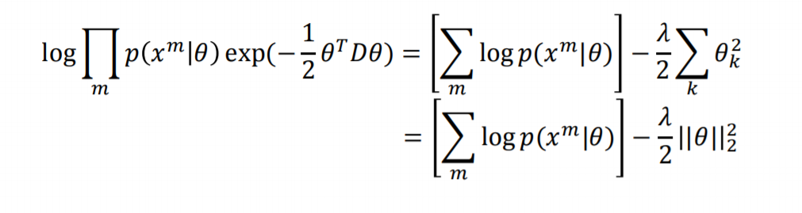
REGULARIZATION

Slide 9
FUTURE WORK

